Slide 1

Presentation on Intelligent Shopping basket.
Guided By:
Prof. Sumita Chandak
Presented By:
Ajaykumar Kushwaha
Gokul Kombath
Saundarya Junjur
Department of Information Technology
Atharva College of Engineering
Mumbai.
Notes:
1. Do not underline headings of topics in the ppt.
2. Instead of design, implementatio and analysis write Block diagram or system architechture.
3. Abstract and problem statement should be in paragraph ( dont use bullets here and write in passive voice) 4. justify ( alignment) for all the ppt content
5. In results and discussion put technology related output screens

Slide 2
ABSTRACT
The ‘Intelligent Shopping Basket’ is a Smart Basket which integrates a Arduino Embedded Chip with RFID code Scanners and a Battery kit to allow users to self checkout at Super Markets.

Slide 3
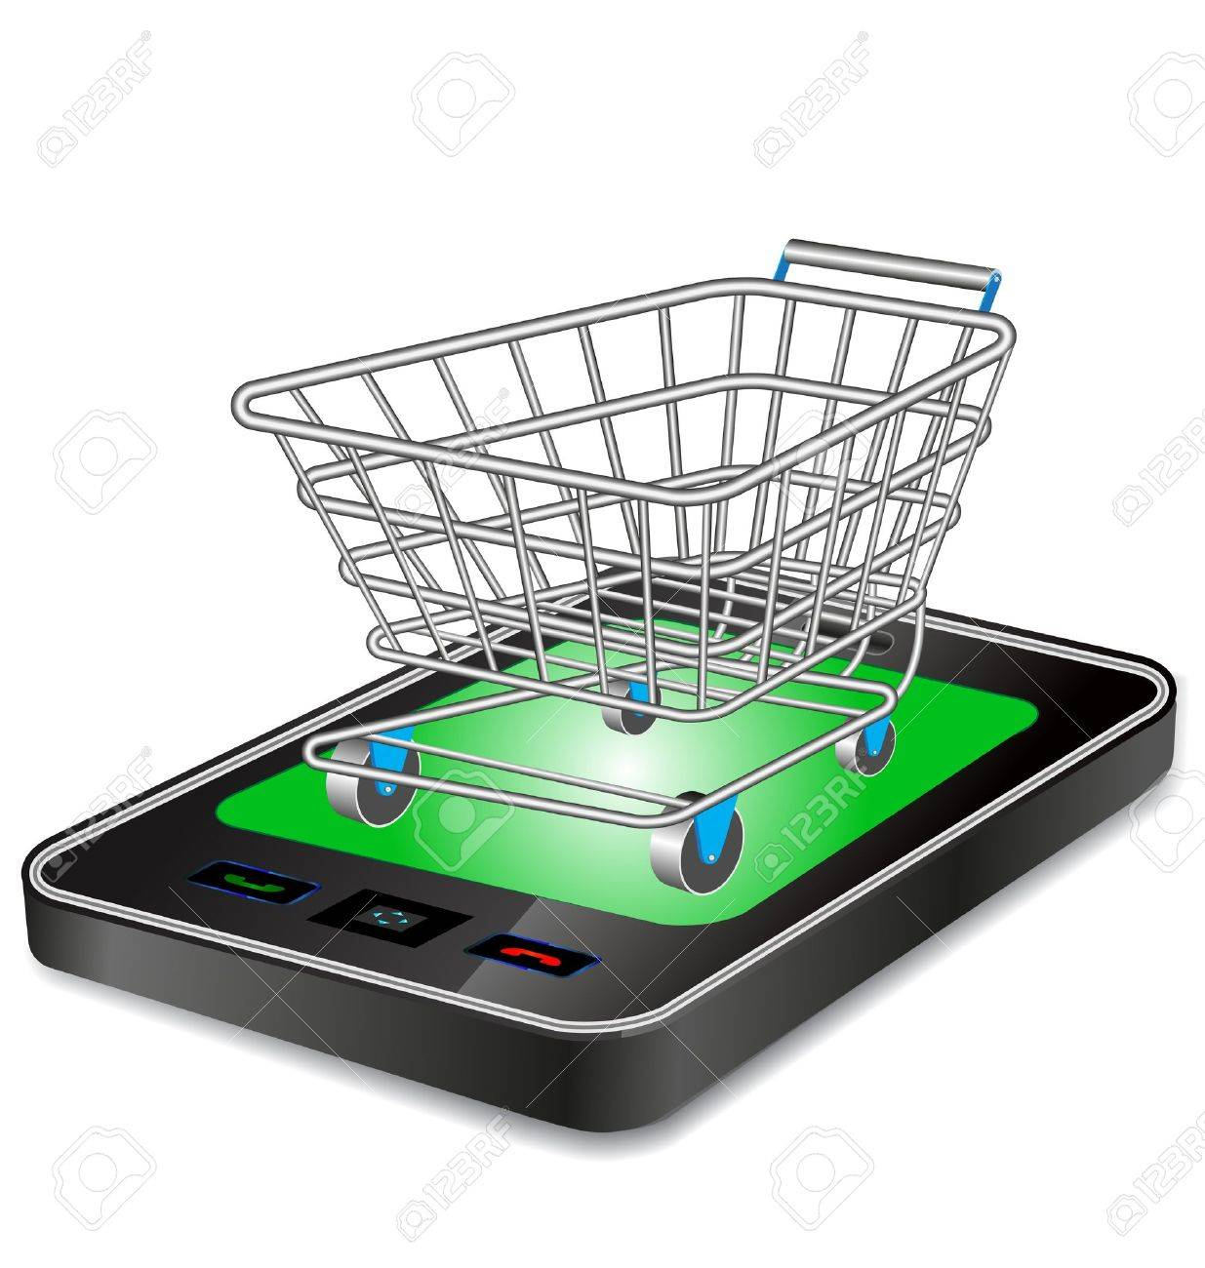
Index
INTRODUCTION
AIMS AND OBJECTIVES
LITERATURE SURVEYED
PROBLEM STATEMENT
SCOPE
BLOCK DIAGRAM
DETAILS OF HARDWARE AND SOFTWARE
CONCLUSION
REFERENCES

Slide 4
INTRODUCTION
In the modern world, every supermarket and hypermarkets employ shopping baskets and shopping trolleys in order to aid customers to select and store the products which they intend to purchase.
The customers have to drop every product which they wish to purchase into the shopping cart and then proceed to checkout at the billing counter.
The billing process is quite tedious and highly time consuming and has created the need for shops to employ more and more human resource in the billing section, and yet waiting time remains considerably high.
In a world where technology is replacing the ways we pursue everyday activity, the future of the retail industry also lies in more and more automated devices.

Slide 5
AIM AND OBJECTIVES
AIM :
The Intelligent Shopping Basket aims to reduce ,and possibly eliminate the total waiting time of customers, lower the total manpower requirement and expenses for markets and increase efficiency overall.
OBJECTIVES:
The main objective of this project is to reduce and eliminate time taken in billing counter in super markets by designing an Intelligent Shopping Basket which uses RFID scanners to allow users to self-checkout and increase productivity time.

Slide 6
Literature Surveyed
Sr.no | Title | Author | Publication | Approach
1 | Smart Trolley using Smart Phone and Arduino | Harpreet Singh Bedi, Nikhil Goyal, Sunil Kumar and Avinash Gupta | Journal of Electrical & Electronic Systems | Customer’s Smartphone acts as the barcode scanner. The code will accept by Arduino Uno through Bluetooth Module.RFID Tags and RFID Reader: The Smart Trolley can be used by those customers who are having the membership card.Whenever a customer put RFID Tag near to RFID Reader,RFID Reader detects the RFID Tag and trolley act as Smart Trolley.
2 | Automated Shopping Trolley for Super Market Billing System | S. Sainath, K. Surender, V. Vikram Arvind | International Journal of Computer Applications (0975 – 8887) | The Automated Shopping Trolley is a Smart Trolley which integrates a Rasberry Pie Embedded Chip with two Bar code Scanners and a Battery kit
3 | Smart Trolley In Mega Mall | Vidya Palve, Arpita Mahale, Apurva Dandgaval, Unnati Deore, Prachi Jadhav | International Journal of Advanced Research in Science and Technology | It follows the customer while purchasing items & it maintain safe distance between customer & itself. Only customer has to hold the Colour code side of the product wrapper in front of colour sensor. By using this trolley customer can buy number of products in very less time with less effort.

Slide 7
PROBLEM STATEMENT
After shopping grocery products in the shopping mall it becomes a challenging task to pay a bill by standing in the queue. The customers have to stand in the billing lines for a lot more time than actual shopping time sometimes.To overcome with these problems we have designed a smart trolley in such a manner that every customer can manage the bill using mobile application in the android system.

Slide 8
SCOPE OF OUR PROJECT
We have to update the details of the product items in the memory unit of trolley time to time. We take the help of Internet of Things and some software with the help of which all information will be updated regularly. Also, with the help of optical sensor, motors, and motor drivers, we will make trolley in such a way that it will follow the customer which purchasing items and it maintains the safe distance between customer and itself. This system is also very cost efficient and user-friendly as most of the work is done on smart phone and requires less power supply.

Slide 9
Block diagram
CLOUD
SMART PHONE
ONLINE PAYMENT
BILLING
COUNTER
BASKET
ARDUINO
AUTOMATED BILL
RFID READER
BARCODE SCANNER
LCD
BATTERY

Slide 10
DETAILS OF HARDWARE & SOFTWARE
Hardware Requirements: | Software Requirements:
Arduino Uno Rev3 | iot cloud platform
USB wifi Device | Android 4.4 Kitkat (Open Source)
Iball Barcode Scanner | Iball Barcode Driver
RFID Reader and Tags (125Khz) | Ionic SDK (open-source )
LCD Screen | Arduino uno driver
10V Battery Kit
Customised Basket

Slide 11
CONCLUSION
The project will demonstrate the possibility of using Arduino and Smart phone for developing a smart shopping system which automates the entire billing procedure. The system developed is highly reliable, fair and cost-effective. With this, shoppers no longer have to wait near counters for payment of bills because of their purchased item information getting transferred to central billing unit. This will enhance the shopping experience to a new level.
Taking into account the changing trend in retail shopping, we come to a conclusion that the Intelligent Shopping Basket is most certainly a definite necessity for the Retail marketing industry to step up their portfolios , cope up with the advancement in technology and save time and manpower.

Slide 12
REFERENCES
“Smart Trolley In Mega Mall”, Vidya Palve, Arpita Mahale, Apurva Dandgarval, Unnati Deore, Prachi Jadhav, International Journal of Advance Research in Science and Engineering Vol No.6, February 2018.
“Automated Shopping Trolley for Super Market Billing System”, S. Sainath, K. Surender, V. Vikram Arvind, International Journal of Computer Applications, 2014
“Smart Trolley using Smart Phone and Arduino”, Harpreet Singh Bedi, Nikhi Goyal, Sunil Kumar, Avinash Gupta, Journal of Electrical and Electronical Systems.
“Automated Smart Trolley with Smart Billing using Arduino”, Suganya R, Swarnavalli N, Vismitha S, Mrs. G.M. Rajathi, International Journal for Research in Applied Science & Engineering Technology (IJRASET), Vol 4, Issue III, March 2016.
“Design and Implementation of a Smart Shopping Cart by RFID Technology”, Nemalidinne Sai Megana, Asian Institute of Technology School of Engineering and Technology, Thailand, May 2018.

Slide 13

THANK YOU!!!

